Slide 1
Teacher Learning Communities - developing expertise through purposeful practice.

Slide 2
We need to focus on classrooms, not schools
School-level differences in value-added are relatively small.
Classroom-level differences in value-added are large.

Slide 3
And most of all, on teachers
The difference between a very effective teacher and a poorly performing teacher is large.
During one year with a very effective maths teacher, pupils gain 40% more in their learning than they would with a poorly performing maths teacher .
Furthermore it matters more for disadvantaged pupils.
Over a school year, for disadvantaged pupils the difference between a good teacher and a bad teacher is a whole year’s learning.
Sutton Trust Report 2011

Slide 4
Teachers do improve, but slowly…
Leigh (2007)

Slide 5
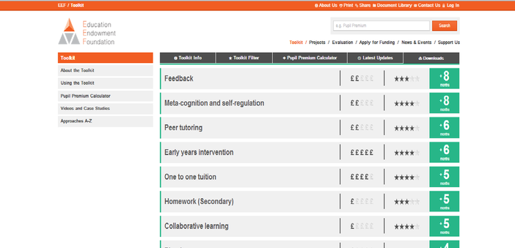
Using evidence to inform the focus for development
We should focus on formative assessment because the evidence strongly suggests that it will make the biggest difference to teacher quality.

Slide 6
The evidence for formative assessment
Fuchs & Fuchs (1986)
Natriello (1987)
Crooks (1988)
Bangert-Drowns et al. (1991)
Kluger & DeNisi (1996)
Black & Wiliam (1998)
Nyquist (2003)
Dempster (1991, 1992)
Elshout-Mohr (1994)
Brookhart (2004)
Allal & Lopez (2005)
Köller (2005)
Brookhart (2007)
Wiliam (2007)
Hattie & Timperley (2007)
Shute (2008)

Slide 7
Unpacking classroom formative assessment
Where the learner is going
Where the learner is
How to get there
Engineering effective discussions, tasks, and activities that elicit evidence of learning
Providing feedback that moves learners forward
Teacher
Clarifying, sharing and understanding learning intentions
Peer
Activating students as learning
resources for one another
Learner
Activating students as owners of their own learning

Slide 8
Expertise
Grandmaster chess players don’t have higher IQs than average chess players
Top surgeons don’t have higher IQs, medical school grades, or higher manual dexterity than average surgeons
In general, measures of general ability account for 4% of the variability in performance

Slide 9
If it is not talent, then what is it?
Elite performance is the result of at least a decade of maximal efforts to improve performance through an optimal distribution of deliberate practice
What distinguishes experts from others is the commitment to deliberate practice

Slide 10
Creating better habits
Improving practice involves changing habits, not adding knowledge:
That’s why it’s hard
And the hardest bit is not getting new ideas into people’s heads. It’s getting the old ones out
That’s why it takes time
Expertise research therefore suggests that they are only beginning to scratch the surface of what we are capable of

Slide 11
Pause for reflection
What’s the most surprising, interesting or challenging thing you have heard so far?
Try to get a consensus with your neighbours.

Slide 12
A model for teacher learning
Content, then process
Content (what we want teachers to change):
Evidence
Ideas (strategies and techniques)
Process (how to go about change):
Choice
Flexibility
Small steps
Accountability
Support
Science
Design

Slide 13
A “signature pedagogy” for teacher learning
Every monthly TLC meeting should follow the same structure and sequence of activities:
Activity 1: Introduction (5 minutes)
Activity 2: Starter (5 minutes)
Activity 3: Feedback (25–50 minutes)
Activity 4: New learning about formative assessment (20–40 minutes)
Activity 5: Personal action planning (15 minutes)
Activity 6: Review of learning (5 minutes)

Slide 14
Activities 1, 2, 3, 5, 6: “Bookends”
For each of these five activities, the process is exactly the same at each TLC meeting
This provides a familiar structure for teachers to get better together
As the structure fades into the background,
The learning comes into the foreground
Teachers come to the meeting knowing what is expected of them

Slide 15
Ground-rules for TLCs
Norms of collaboration (Garmston & Wellman, 1999)
Seven powerful Ps
Pausing
Paraphrasing
Probing
Putting ideas on the table (and pulling them off!)
Paying attention to self and others
Presuming positive intentions
Pursuing a balance between advocacy and inquiry

Slide 16
The first three activities
Activity 1: Introduction - Sharing learning intentions for the meeting
Activity 2: Starter - A variety of warm-up activities to get participants’ minds to the meeting
Activity 3: Feedback - Routines need to be established, expectations shared, and structure maintained.

Slide 17
Activity 4 (part 1): New learning about AfL
Drip-feed’ of new ideas, to increase knowledge, and to produce variety
Watch videos of classroom practice
Book study (one chapter each month)
Research articles
Blogs

Slide 18
Example TLC 1.2
What makes an effective learning objective?
Read the quotation at the top and in pairs do the short TASK about separating learning objectives from context.
Now read the information at the bottom of the sheet and discuss with your partner.

Slide 19
Activity 4 (part 2): Choosing techniques to embed
Teachers are responsible for choice of techniques:
Allows for customization; caters for local context and individual experience
Creates ownership; shares responsibility
Develops teachers’ own unique strengths
Teachers choose one or two techniques to embed over the coming month

Slide 20
Example TLC 1.3
Ensuring engagement with the lesson objective
Read through the choice of techniques an select one that you want to embed in your own practice over a 4 week period.
Share what you intend to do with your partner.

Slide 21
Activity 5 (part 1): Personal action planning
Each teacher updates his or her personal action plan
Makes a specific commitment about what they will do over the coming month
Arranges any support needed from colleagues
Specific date and time for peer observation

Slide 22
Activity 5 (part 2)Peer observation
Run to the agenda of the observed, not the observer:
Observed teacher specifies focus of observation:
e.g., teacher wants to increase wait time
Observed teacher specifies what counts as evidence:
e.g., provides observer with a stopwatch to log wait times
Observed teacher owns any notes made during the observation

Slide 23
Why teachers shouldn’t work alone.
93% of Americans and 69% of Swedes think they are above average drivers (Svenson, 1981)
94% of college professors report doing above average work (Cross, 1997)
People think they are at lower risk than their peers for heart attacks, cancer, food poisoning, etc. (Weinstein, 1980)
Strangers predict your IQ better than you do (Borkenau & Liebler, 1993)
People believe they are more accurate than their peers at self-assessment (Pronin, Lin, & Ross, 2002)

Slide 24
Activity 6: Wrap
Did the meeting meet its intended objectives
If yes, great
If no, time to plan what to do about it

Slide 25
Teacher learning communities
Plan that the TLC will run for two years.
Identify 10 to 14 interested colleagues
Secure institutional support for
Monthly meetings (75–120 minutes each, inside or outside school time)
Time between meetings (two hours per month in school time):
Collaborative planning
Peer observation
Any necessary waivers from school policies

Slide 26
Impact on teaching standards after first 2 years
Six members of full time staff did both years of the Embedding Formative Assessment model
 | Judgement prior to TLCs | Judgement after first 2 years of TLCs
Teacher 1 | Good | Out
Teacher 2 | Sat | Good/Out
Teacher 3 | Sat | Good
Teacher 4 | Good/Out | Out
Teacher 5 | Sat/Good | Good
Teacher 6 | Good/Out | Out

Slide 27
What have been the direct effects at Hunter’s Bar?
Leading indicators of success
Teacher quality has improved
Teachers increasingly act as “critical friends” to others
There is a prevalence of classroom formative assessment practices
Children are highly engaged in classrooms
Teachers modify the techniques in appropriate ways, indicating an understanding of the underlying theory
There is a shift in the ownership of the reform
Research and evidence is considered before any major decisions and is part of all professional development

Slide 28
And the indirect effects?
Quality of staff meetings (now known as Professional Development Meetings).
Quality professional dialogue in school
People asking informed questions based on research and personal analysis
All teachers in school asking, ‘What does the evidence tell us?’
Children’s increased awareness about learning to learn (metacognition)
TLC principles being used in other areas of professional development
Changes in the interaction and involvement of children in assemblies

Slide 29
Summary
Raising achievement requires improving teacher quality
Improving teacher quality requires teacher professional development
To be effective, teacher professional development must address:
What teachers do in the classroom
How teachers change what they do in the classroom
Classroom formative assessment + teacher learning communities:
A point of (uniquely?) high leverage

Slide 30
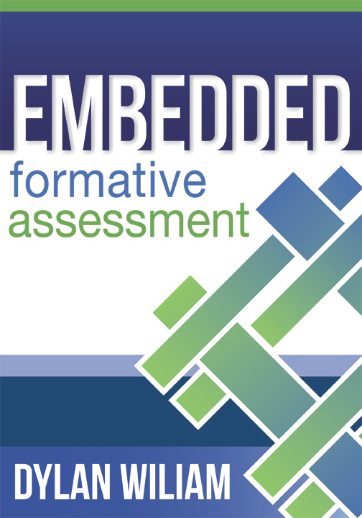
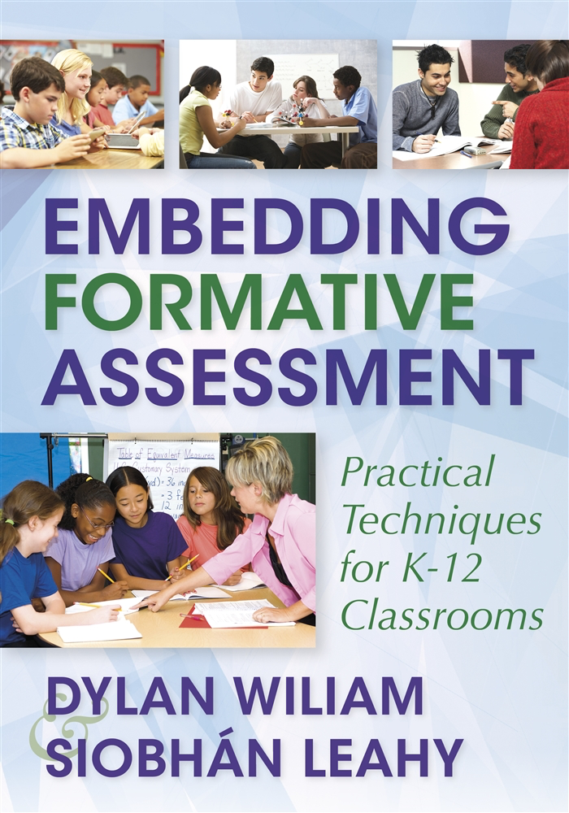
To find out more…
www.dylanwiliam.net

Slide 31
We need to create time and space for teachers to reflect on their practice in a structured way, and to learn from mistakes.
(Bransford, Brown & Cocking, 1999)

