Slide 1
Sustaining Improvement in Teacher Professional Development
Teacher Learning Communities AT Hunter's bar junior school.

Slide 2
There is no such thing as a good school
At the secondary level, attainment at the end of primary school is the most dominant factor in explaining pupil performance at GCSE.
At the primary level, pupil-level factors (e.g. family income, parental education) that were present before entry into schooling explain the majority of variation in pupil performance.
Most research points towards there being little variation in the relative effectiveness of schools once pupil background characteristics are controlled for.
‘How intake and other external factors affect school performance’ –RISE REVIEW, RESEARCH AND INFORMATION ON STATE EDUCATION January 2013

Slide 3
We need to focus on classrooms, not schools
School-level differences in value-added are relatively small.
Classroom-level differences in value-added are large.
Conclusion
As long as you go to school, it doesn’t matter very much which school you go to.
But it matters very much which classrooms you are in.

Slide 4
And most of all, on teachers
The difference between a very effective teacher and a poorly performing teacher is large.
During one year with a very effective maths teacher, pupils gain 40% more in their learning than they would with a poorly performing maths teacher .
Furthermore it matters more for disadvantaged pupils.
Over a school year, for disadvantaged pupils the difference between a good teacher and a bad teacher is a whole year’s learning.
Sutton Trust Report 2011

Slide 5
Teachers do improve, but slowly…
Leigh (2007)

Slide 6
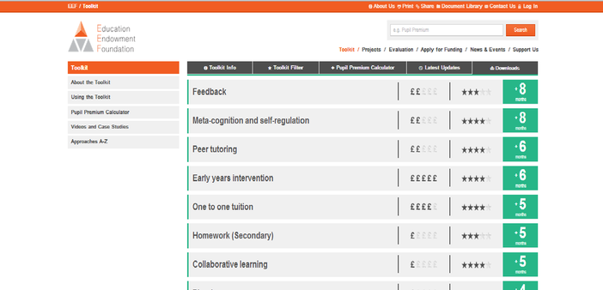
So, if we are going to focus on teachers…
We should focus on formative assessment because the evidence strongly suggests that it will make the biggest difference to teacher quality.

Slide 7
Pause for reflection
What’s the most interesting, surprising, or challenging thing you have heard so far?
See if you can get consensus with your neighbours.

Slide 8
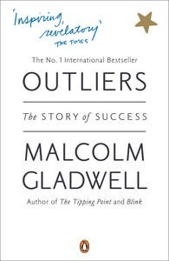
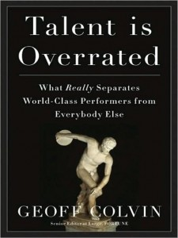
Talent is over-rated…

Slide 9
Expertise
Grandmaster chess players don’t have higher IQs than average chess players
Top surgeons don’t have higher IQs, medical school grades, or higher manual dexterity than average surgeons
In general, measures of general ability account for 4% of the variability in performance

Slide 10
If it is not talent, then what is it?
Elite performance is the result of at least a decade of maximal efforts to improve performance through an optimal distribution of deliberate practice
What distinguishes experts from others is the commitment to deliberate practice

Slide 11
Looking at the wrong knowledge
The most powerful teacher knowledge is not explicit:
That’s why telling teachers what to do doesn’t work
What we know is more than we can say
And that is why most professional development has been relatively ineffective

Slide 12
Creating better habits
Improving practice involves changing habits, not adding knowledge:
That’s why it’s hard
And the hardest bit is not getting new ideas into people’s heads
It’s getting the old ones out
That’s why it takes time

Slide 13
Why teachers shouldn’t work alone.
93% of Americans and 69% of Swedes think they are above average drivers (Svenson, 1981)
94% of college professors report doing above average work (Cross, 1997)
People think they are at lower risk than their peers for heart attacks, cancer, food poisoning, etc. (Weinstein, 1980)
Strangers predict your IQ better than you do (Borkenau & Liebler, 1993)
People believe they are more accurate than their peers at self-assessment (Pronin, Lin, & Ross, 2002)

Slide 14
Recap
An effective school is a school full of effective classrooms.
There is a significant difference between a good performing teacher and a poor one.
Teacher improvement slows by year 5.
To create better teachers we need to create better teaching habits.
If we are going to improve teachers we need to improve formative assessment because the evidence drives us there.
Teaching is an expert profession. Experts excel by doing purposeful practise.
Just telling teachers what to do doesn’t lead to improvement.
People are poor judges of their own abilities, we need others to give us feedback.

Slide 15
A model for teacher learning
Content, then process
Content (what we want teachers to change):
Evidence
Ideas (strategies and techniques)
Process (how to go about change):
Choice
Flexibility
Small steps
Accountability
Support
Science
Design

Slide 16
Teacher learning communities
Plan that the TLC will run for two years.
Identify 10 to 12 interested colleagues:
Secure institutional support for:
Monthly meetings (75–120 minutes each, inside or outside school time)
Time between meetings (two hours per month in school time):
Collaborative planning
Peer observation
Any necessary waivers from school policies

Slide 17
A “signature pedagogy” for teacher learning
Every monthly TLC meeting should follow the same structure and sequence of activities:
Activity 1: Introduction (5 minutes)
Activity 2: Starter (5 minutes)
Activity 3: Feedback (25–50 minutes)
Activity 4: New learning about formative assessment (20–40 minutes)
Activity 5: Personal action planning (15 minutes)
Activity 6: Review of learning (5 minutes)

Slide 18
What have been the direct effects at Hunter’s Bar?
Leading indicators of success
Teacher quality has improved
Teachers increasingly act as “critical friends” to others
There is a prevalence of classroom formative assessment practices
Children are highly engaged in classrooms
Teachers modify the techniques in appropriate ways, indicating an understanding of the underlying theory
There is a shift in the ownership of the reform
Research and evidence is considered before any major decisions and is part of all professional development

Slide 19
Impact on teaching standards after first 2 years
Six members of full time staff did both years of the Embedding Formative Assessment model
 | Judgement prior to TLCs | Judgement after first 2 years of TLCs
Teacher 1 | Good | Out
Teacher 2 | Sat | Good/Out
Teacher 3 | Sat | Good
Teacher 4 | Good/Out | Out
Teacher 5 | Sat/Good | Good
Teacher 6 | Good/Out | Out

Slide 20
And the indirect effects?
Quality of staff meetings (now known as Professional Development Meetings).
Quality professional dialogue in school
People asking informed questions based on research and personal analysis
All teachers in school asking, ‘What does the evidence tell us?’
Children’s increased awareness about learning to learn (metacognition)
TLC principles being used in other areas of professional development
Changes in the interaction and involvement of children in assemblies

Slide 21
Developments this year?
In September we joined the Teacher Development Trust.
We started Lesson Study in school and have so far done 5 rounds in each year group.
Lesson Study has supported the work of formative assessment and fed back into TLC meetings.
We are running Teaching Assistant TLCs.

Slide 22
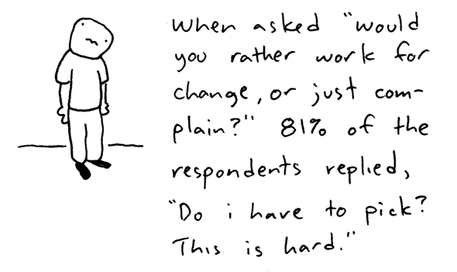
The biggest possible barrier is change

Slide 23
Over to you
What are the forces that will support or drive the adoption of formative assessment practices in your school?
What are the forces that will constrain or prevent the adoption of formative assessment practices in your school?
+
—
Force-field analysis (Lewin, 1954)

Slide 24
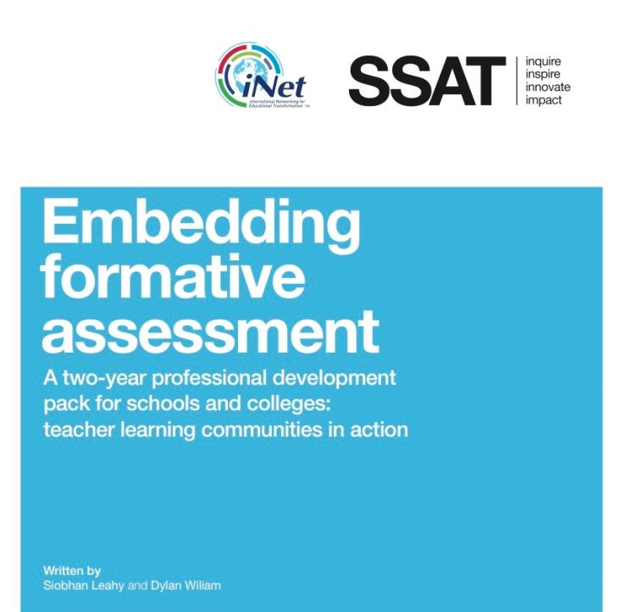
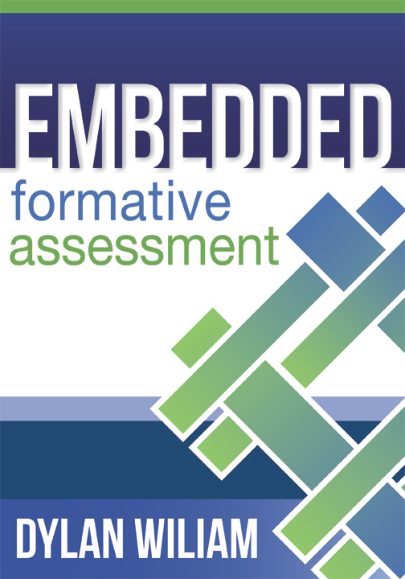
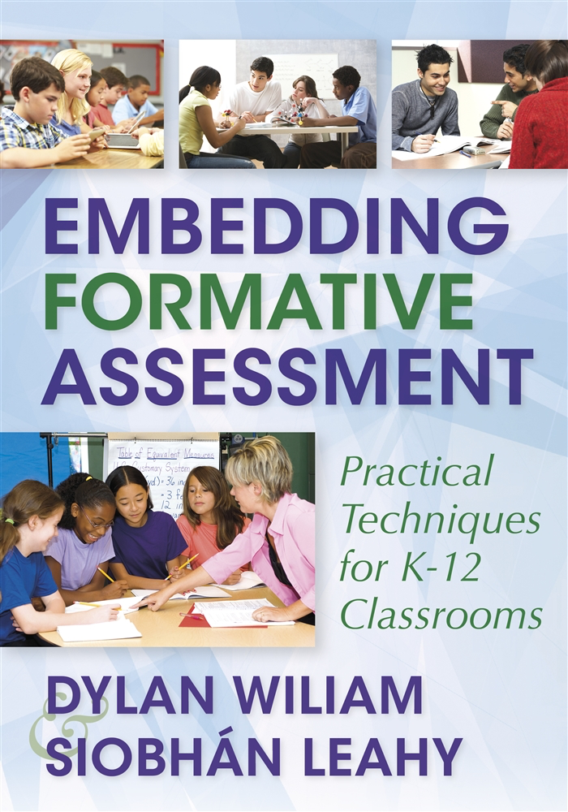
To find out more…
www.dylanwiliam.net

Slide 25
We need to create time and space for teachers to reflect on their practice in a structured way, and to learn from mistakes.
(Bransford, Brown & Cocking, 1999)

